Slide 1
Water Quality Monitoring and Surveillance UAV

Slide 2
Water Quality
It is a measure of the condition of water relative to the requirements of one or more biotic species and or to any human need or purpose.
Water quality depends on the local geology and ecosystem, as well as human uses such as sewage dispersion, industrial pollution, use of water bodies as a heat sink, and overuse (which may lower the level of the water).

Slide 3
Indicators of water quality
These are the variables that describe the suitability of a particular water sample towards fulfilment of a particular requirement such as drinking, industrial use, agricultural use etc.
A comprehensive water quality analysis can include more than hundred different variables which describe the physical, chemical and biological characteristics of water.

Slide 4
Basic Indicators of Water Quality
Dissolved Oxygen
Temperature
Transparency
pH
Electrical Conductivity
Total Dissolved Solids(TDS)
Total Suspended Solids(TSS)
Concentration of metals
Faecal coliforms

Slide 5
The indicators of water quality such as Temperature, Electrical Conductivity, Dissolved Oxygen, total suspended solids give us the bare minimum information on which a crude assessment of overall water quality can be based.

Slide 6
Temperature
Temperature is a physical property that affects the DO level and metabolic rates of aquatic organisms.
It is influenced when there is runoff during rainfall from heated pavements and roads.
Discharge of heated water from nuclear power plants and dams.
Sudden change in water temperature adversely affects the DO level of water.
As temperature rises DO level decreases but the metabolic rates of aquatic organisms increase leaving them weak and susceptible to diseases[1].

Slide 7
Conductivity
Conductivity is a measure of water’s capability to pass electrical flow[2].
Conductivity is an indicator of TDS, salinity in a waterbody.
Changing conductivity is an indication of pollution.
Most aquatic species have adapted to specific salinity levels . Salinity values outside of a normal range can result in fish kills due to changes in dissolved oxygen concentrations, osmosis regulation and TDS toxicity
Salinity can induce water stratification in water bodies with less flow, This is particularly deprimental to water bodies used for water supply.

Slide 8
pH
pH is an indication of the amount of hydrogen ions in water
The majority of aquatic creatures prefer a pH range of 6.5-9.0[3].
pH of water can change due to acid rain(pH lower than 5) and discharge of other pollutants.
A slight change in the pH of water can increase the solubility of phosphorus and other nutrients – making them more accessible for plant growth.

Slide 9
Dissolved Oxygen(DO)
Dissolved oxygen refers to the level of free, non-compound oxygen present in water or other liquids. It is an important parameter in assessing water quality because of its influence on the organisms living within a body of water.
The level of DO in water is very important as it is influenced by several factors directly and indirectly.
Temperature, water agitation, depth etc. affects the DO level directly.
Presence of organic wastes, agricultural runoff, industrial effluents which promote excessive growth of algae and other bacteria have an indirect effect on water DO level.
Water deficient or excessive in DO cannot sustain aquatic life.

Slide 10
Dissolved oxygen refers to the level of free, non-compound oxygen present in water or other liquids. It is an important parameter in assessing water quality because of its influence on the organisms living within a body of water. In limnology (the study of lakes), dissolved oxygen is an essential factor second only to water itself ¹. A dissolved oxygen level that is too high or too low can harm aquatic life and affect water quality.
Where there are no laboratories within a reasonable distance of the sampling stations, field analysis may be the only feasible way to obtain water quality information. Mobile laboratories are expensive to set up and maintain, while a temporary laboratory is justified only if a large sampling and analysis programme is to be carried out within a relatively compact sampling area.

Slide 11
Water Sampling
Usually carried out by a team consisting of several members depending upon the number of samples to be collected.
The water is collected in glass/plastic bottle taking necessary precautions.
Temperature, DO, pH and conductivity measurements are usually made in situ as their value changes quite quickly if proper precautions are not taken.
Other important water quality parameters such as presence of metals, ions, faecal coliform etc is usually carried out at a laboratory.

Slide 12
Level I laboratories are small laboratories located at or near the sampling location. These were originally established for determination of sediment load only, but now can also be used for determination of the water quality field parameters.
Higher level laboratories (levels II and II+) are usually located in major cities and provide analytical capacity to a larger region covering more sampling locations.

Slide 13
Limitations of Current Water Sampling Techniques
Requires the effort of a large number of people spanning several days to collect water quality parameters of major waterbodies.
As the water quality parameters change spatially and temporally sample collection has to be carried out at regular intervals of time at several locations spanning the water bodies. For such purposes it might be required by the personnel to frequently visit these locations either by hiring a boat or buying one.
It might not always be possible to collect samples manually by personnel due to the inaccessibility of the location.
Field staff might encounter a wide range of hazards in the course of their work. Ex. Accessing water that is highly contaminated with chemicals, sewage, bacteria etc. They might require special training to handle such situations effectively.

Slide 14
Some water quality parameters such as Temperature, DO, pH, conductivity have a small window of time before they can be reliably measured. Additional precautions have to be taken for their care if not measured in situ.

Slide 15
Requirements
Possible to carry out measurements at several depths
Autonomous navigation to the required waypoint
UAV should be able to land and take off from water
Should bring back sufficient sample for testing
Operation should not cause to humans

Slide 16
Possible Solutions using UAV
UAV Hovering over water
UAV landing on water

Slide 17
UAV Landing on Water
Pros
Helps to save power as the quadcopter motors are not functioning during sample collection.
Opens up the possibility of carrying out in situ measurements of certain water quality parameters.
Cons
If waves are high it will become difficult for the UAV to take off.
Problem of shielding the sensitive electronic components from water.
Lower payload capacity as floatation devices and water proofing are required.

Slide 18
UAV Hovering
Pros
No problem for electronics from water corrosion.
No need to design specific structure or add floatation devices for the UAV to land on water thus increasing the payload capacity.
Cons
Wastage of power to maintain accurate position of UAV during sample collection
Under an emergency the UAV might need to land on water if it is far from the bas.
Difficult to carry out in situ measurements,

Slide 19
Payloads
DO meter
pH meter
Conductivity meter
Temperature senor

Slide 20
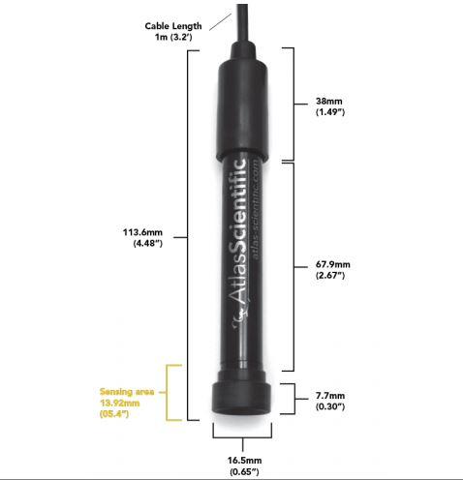
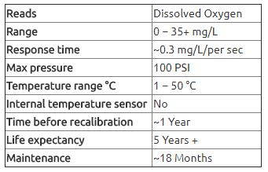
DO Meter

Slide 21
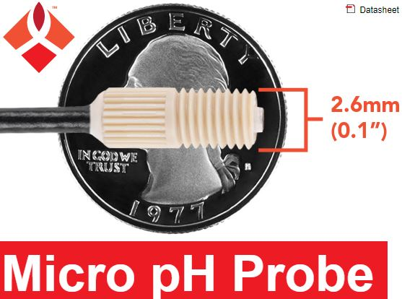
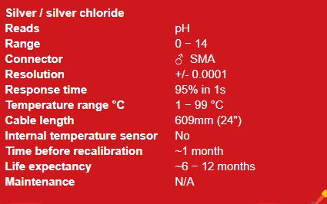
pH meter

Slide 22
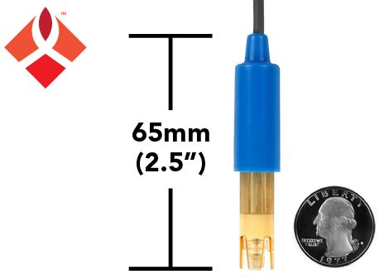
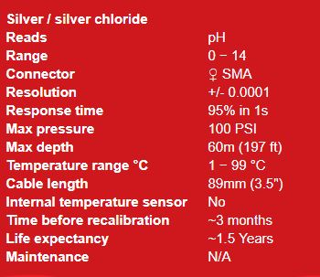

Slide 23
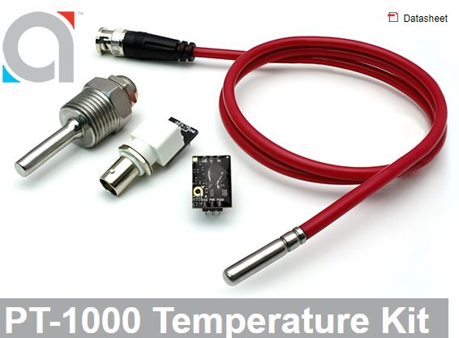
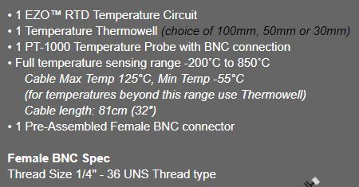
Temperature Sensor

Slide 24
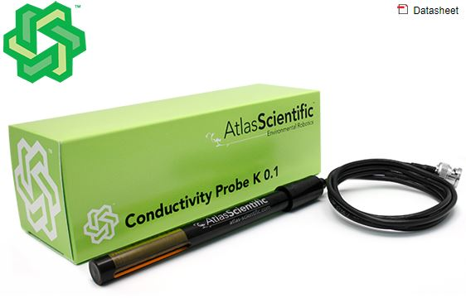
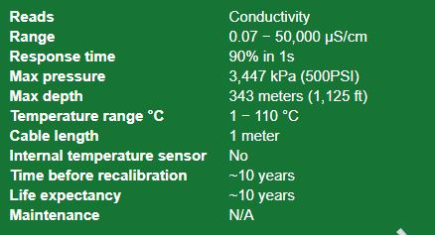
Conductivity Meter

Slide 25
UAV
Descend until water is detected
Stop the motors when water is detected
Navigate to the waypoint
Deploy the sensor in water
Store the data
Wait till readings stabilise

Slide 26
Bibliography
http://www.cotf.edu/ete/modules/waterq3/WQassess4h.html
https://www.fondriest.com/environmental-measurements/parameters/water-quality/conductivity-salinity-tds/
https://www.fondriest.com/environmental-measurements/parameters/water-quality/ph/
https://en.wikipedia.org/wiki/Water_quality
http://www.kerenvis.nic.in/Database/Waterpollution_834.aspx

Slide 27
Water proof
https://patents.google.com/patent/US20150102159A1/en

